Slide 1

Online Learning Experience Setting Expectations
Laura McGibney
January 2024

Slide 2
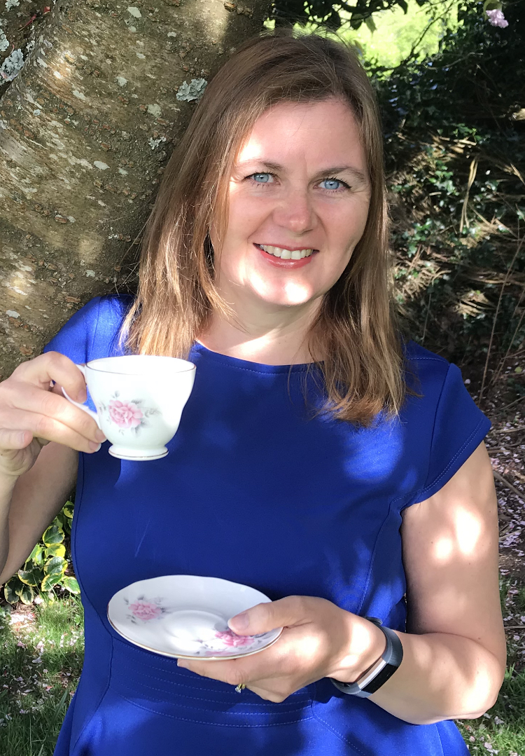
Laura McGibney
Working in SETU since 1993
Degree in Computing part-time (7 years by night)
Worked as HR/Office Manager for software company for 2 years (during career break)
Qualified life and business coach
Online Engagement Advisor since Jan 2020
My role is to offer additional support to you on your online journey

Slide 3
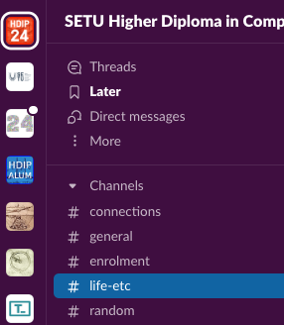
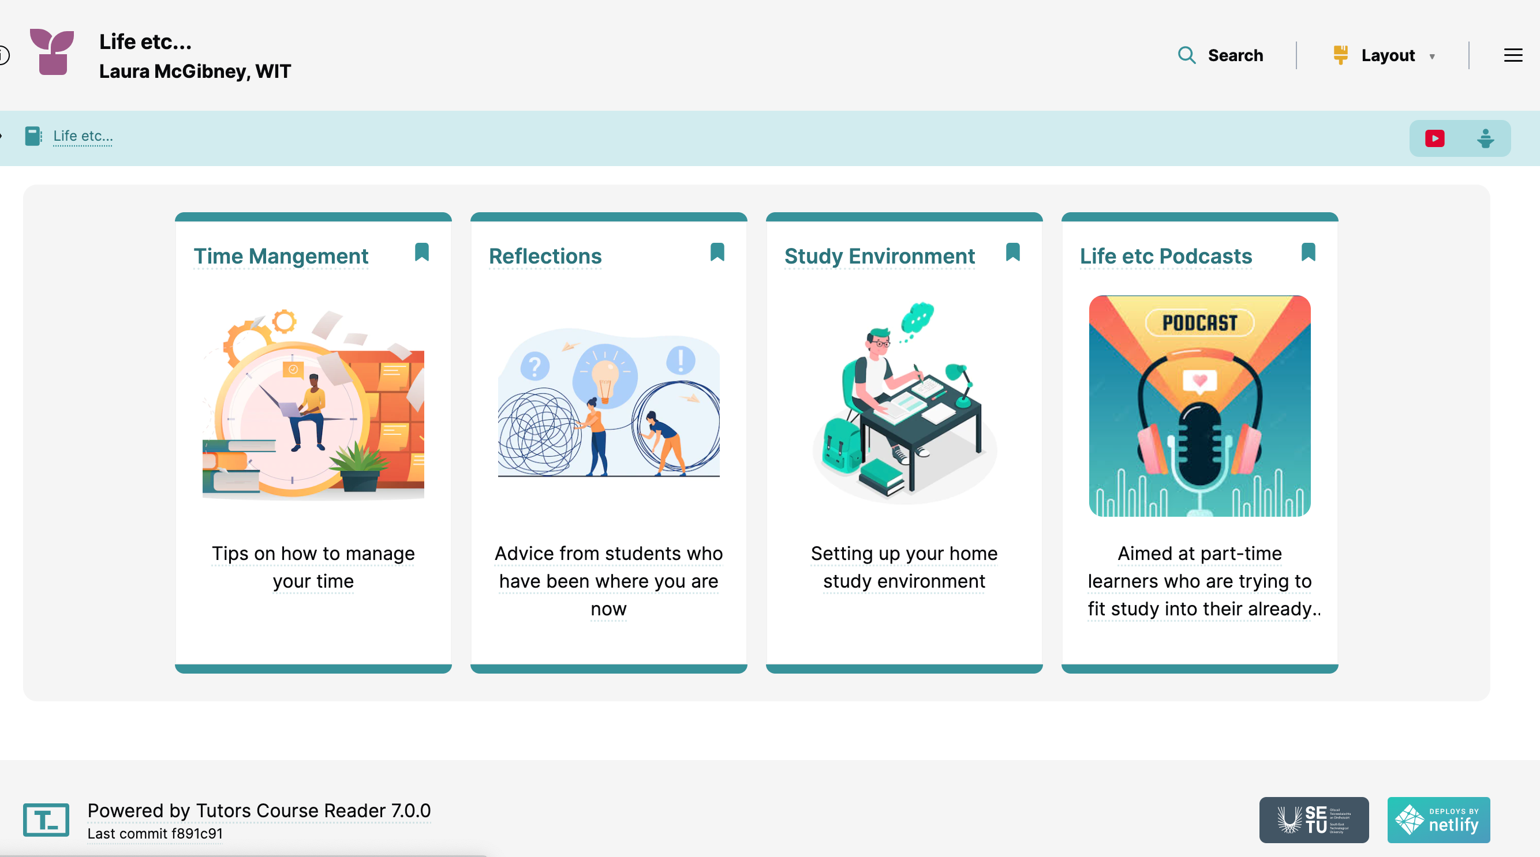
Where to find me:

Slide 4




Slide 5
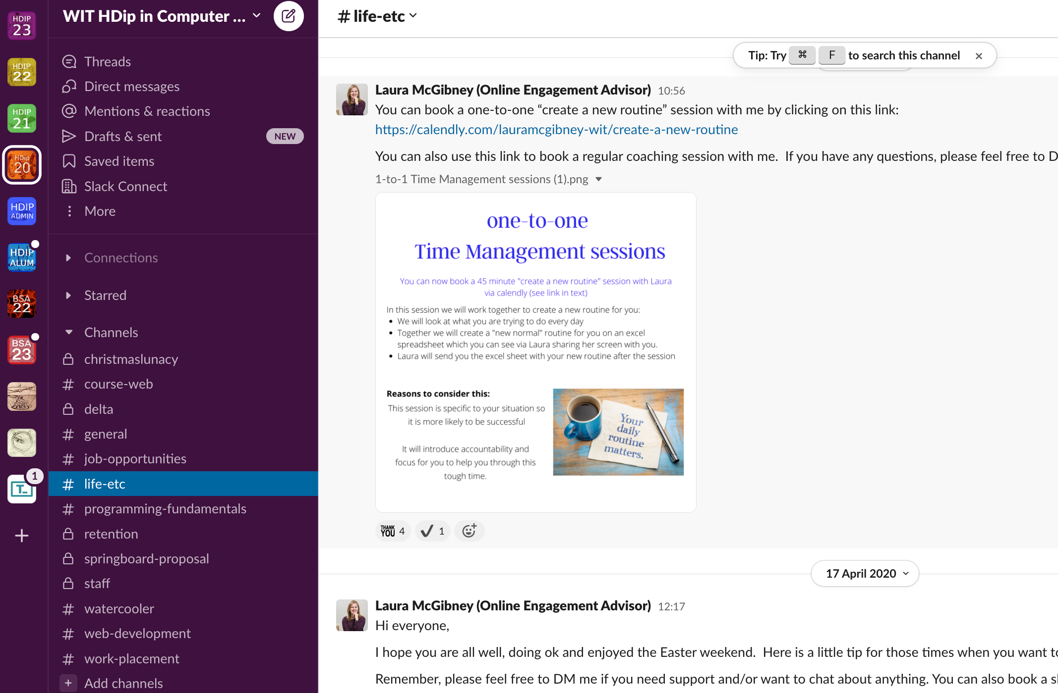

Slide 6

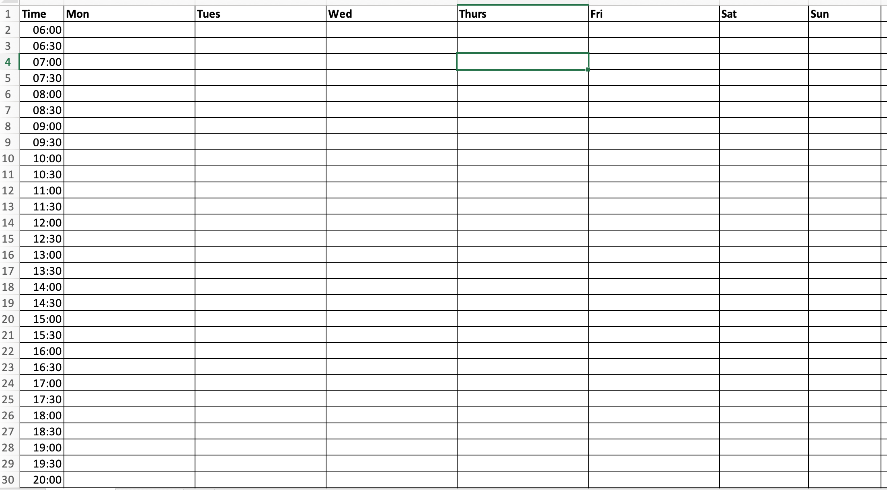
Time Management

Slide 7
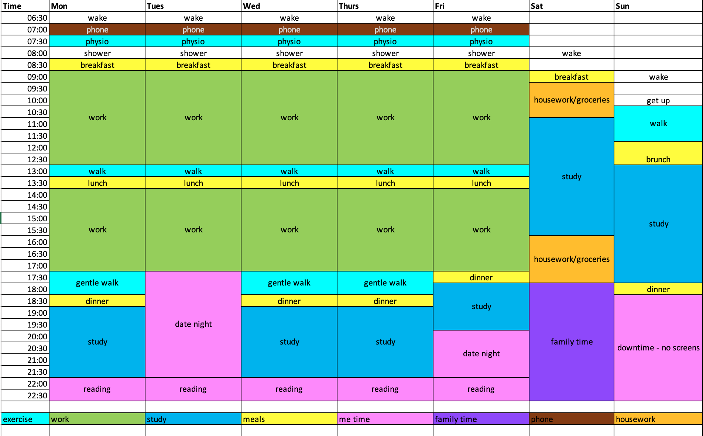

Slide 8
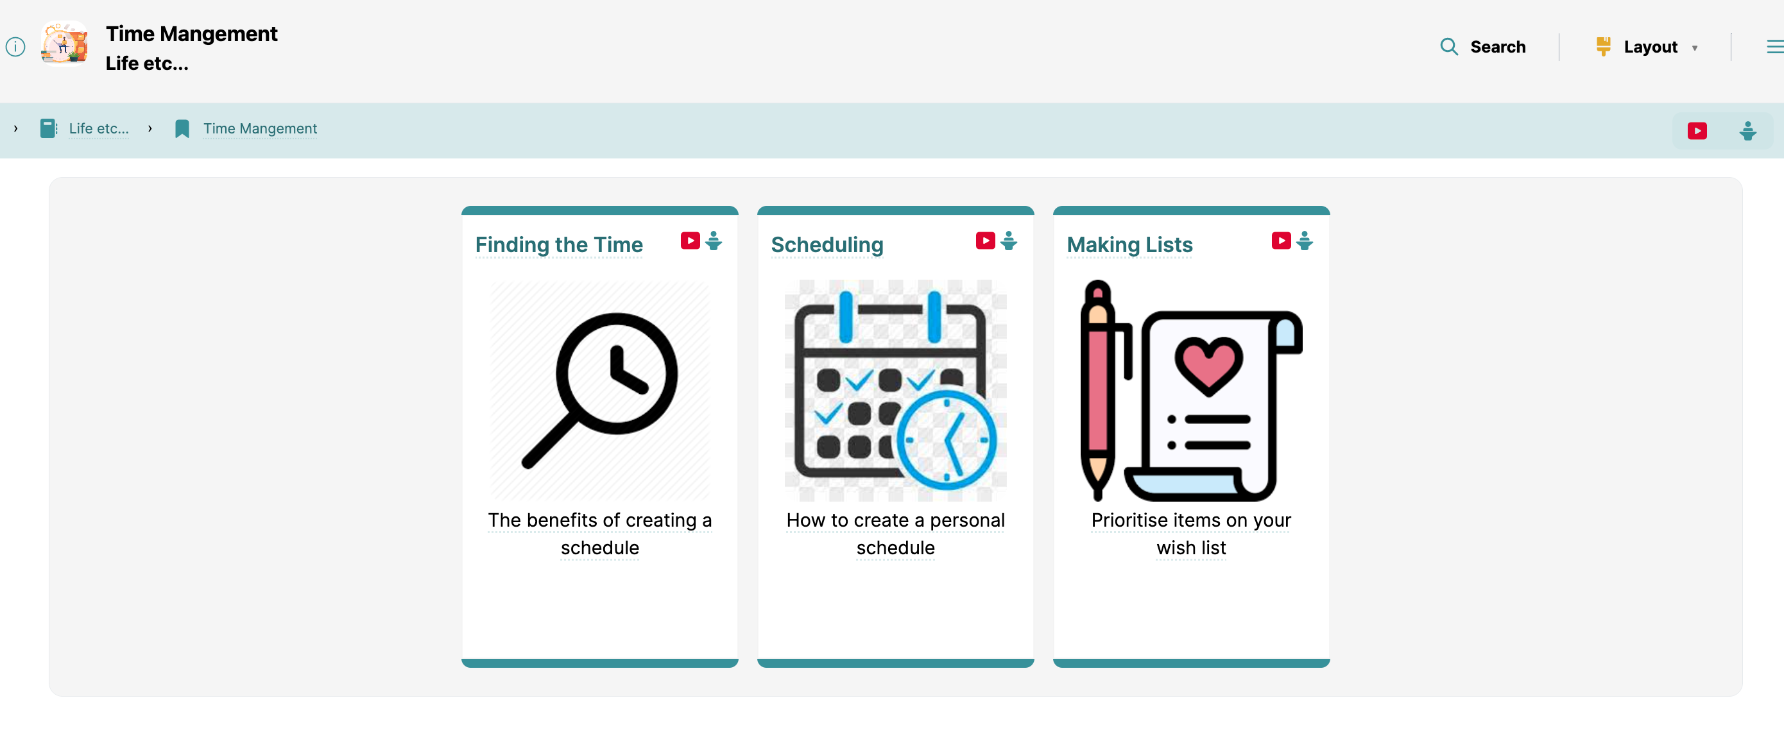

Slide 9

You

Slide 10


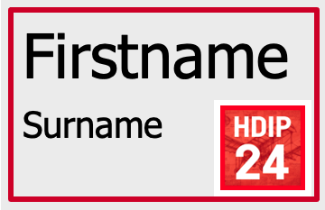
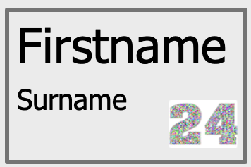
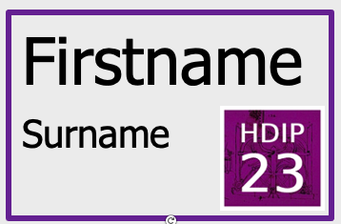
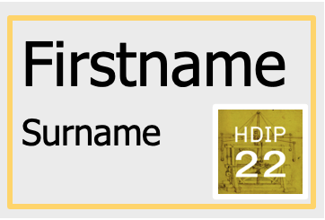
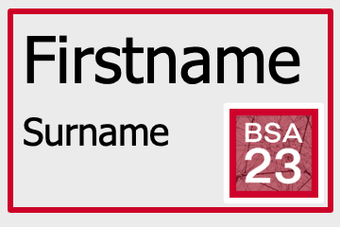

Slide 11

Find your class

Slide 12




Left front: HDip in Computer Science 2024
Right front: HDip in Computer Science 2023
Left back: HDip BSA 2024
Right back: HDip BSA 2023

Slide 13

Mindset

Slide 14
How are you feeling about starting this programme?

Slide 15
Mindset
Set of beliefs that shape how you make sense of things
Influences how you think, feel and behave
What you believe impacts the outcome

Slide 16
Mindset
Stay in the now – see the value of the journey
Put the word “yet” into your vocabulary
What are you telling yourself?
Notes:
If you are too fixed on the end result you miss out on learning along the way I haven’t mastered it yet – changes perspective from can’t do to you can overcome the struggle
Become aware of your thoughts. Replace any negative thought patterns with facts.

Slide 17

Background

Slide 18
Which of these statements best describes you?
Right: Significant ICT experience (ICT qualification/employment)
Left: Some ICT experience (interest/hobby/short courses)
Back: Completely new to the area
BSA students: Experience in the area

Slide 19

Connection

Slide 20
Which of these statements best describes you?
Right: Want to connect with classmates
Left: Like some connection
Back: Neutral/don’t feel it is essential

Slide 21
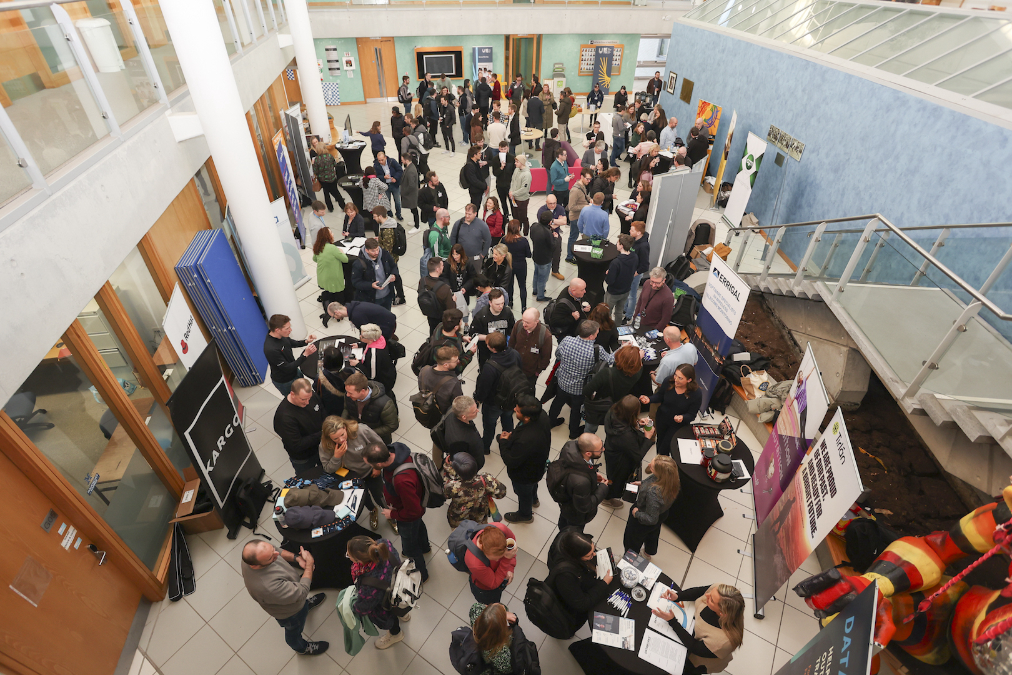
Getting to know your classmates

Slide 22

Questions

Slide 23
What if I can’t grasp the concept/module?
How much time do I need to put in every week?

Slide 24

Location

Slide 25
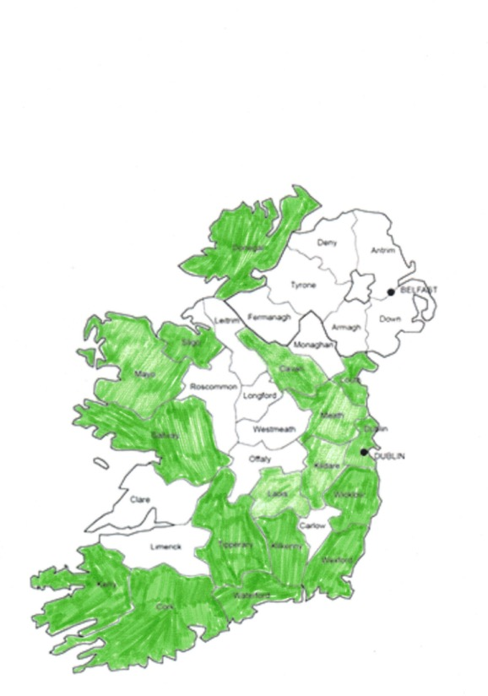
Where are you?
Cork 18
Dublin 7
Waterford 5
Galway 4
Tipperary 4
Kilkenny 3
Wexford 3
Meath 2
Kildare 2
Laois 2
Louth 2
Cavan, Sligo, Wicklow, 1 Donegal, Mayo, Kerry
HDip CS 2024

Slide 26

Opportunity

Slide 27

Time for a cuppa

Slide 29
Location

Slide 30
Where are you from?
Left: South West IT118 – Siobhan Roche
Cork, Kerry
Right: South East/North West IT119 – Mairead Meagher
Waterford, Tipperary, Wexford, Wicklow, Kilkenny, Galway, Sligo, Donegal, Mayo
Back: East IT120 – Peter Windle
Dublin, Louth, Meath, Kildare, Laois, Cavan

Slide 31
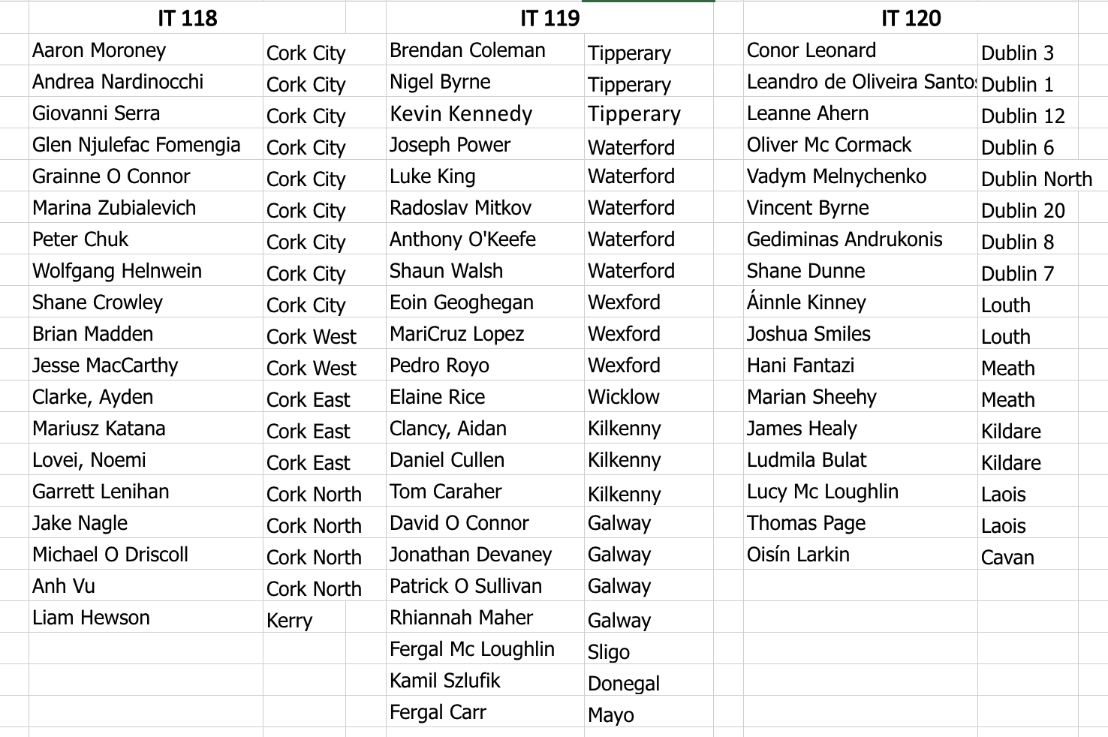

Slide 32
